Slide 1
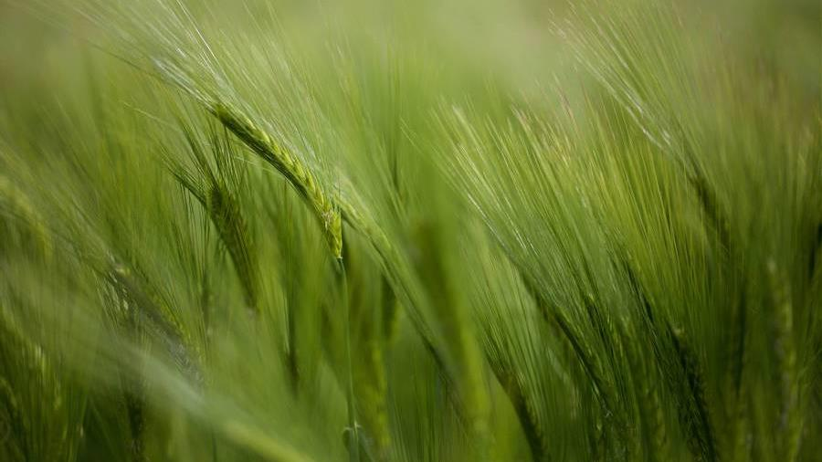





Team Number - SHAH1149 Team Name – Elite Barbs Name of Team Leader – Kinshuk Dewari Name of Team Members – Vipul Chauhan Hardik Singh Aditya Balodi Institution Name - – Graphic Era Hill University, Dehradun

Slide 2

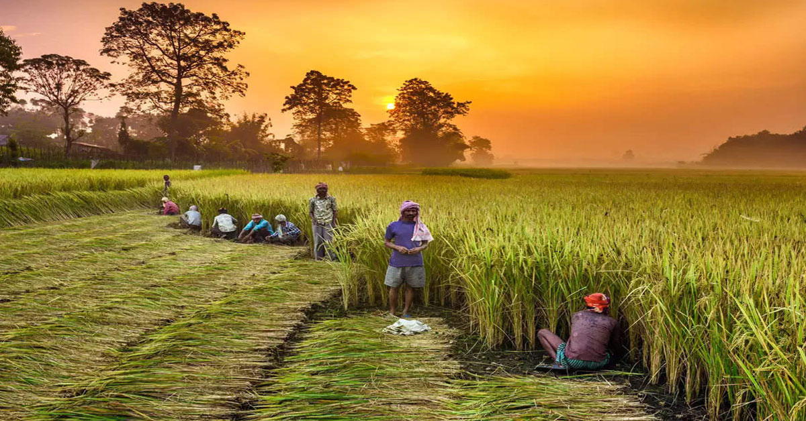
KRISHI UTTHAN
(Farmers Upliftment)
Notes:
Smart health agriculture and hygiene

Slide 3
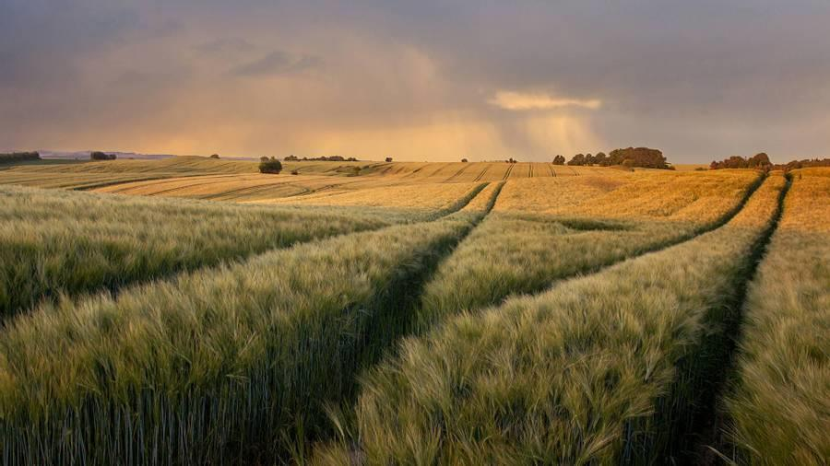
Creating a platform that uses machine learning to optimize the use of fertilizers and pesticides in agriculture, Detect diseases in plants, reducing costs and environmental impact and maximizing the productivity.
PROBLEM STATEMENT :-
DESCRIPTION OF PROBLEM STATEMENT :-
Use of Fertilizers :-
Wrong Fertilizer
Excess amount
Insufficient Amount
Sometimes the farmers are unable to detect diseases that are affecting crop production.
Rural Farmers lack knowledge about optimum crop plantation.
Smart Logistics

Slide 4
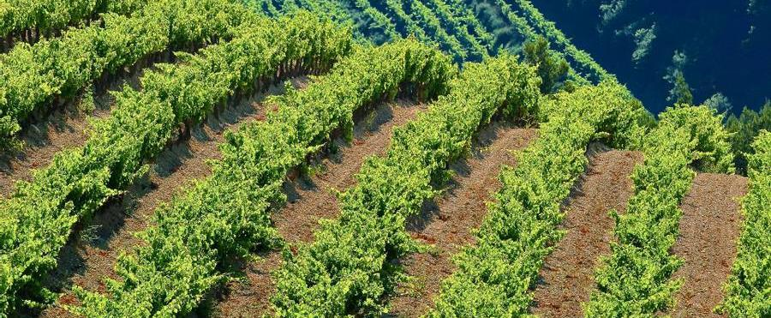







SOLUTION – We not only predict the diseases based on photos but also tell you how to cure it.
We tell you what type of crop to plant based on certain parameters of your soil.
Fertilizer recommendation that is best suited for the particular soil and for the crop that you have grown.
Recommend farmers how much crop they had to cultivate in order to reduce the logistic loss and sell the crop before the harvest is spoiled.
TECHNOLOGY
USED -

Slide 5

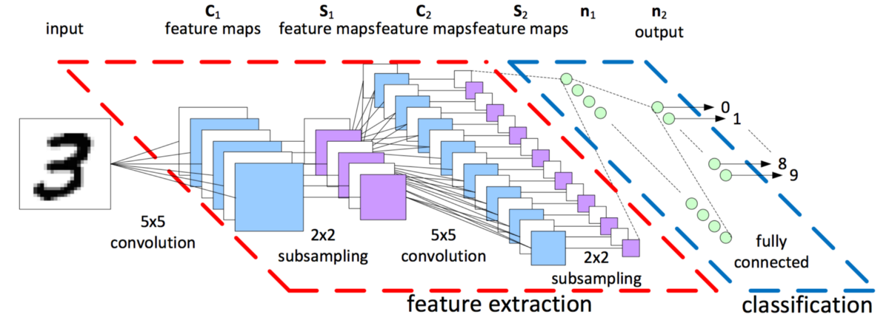

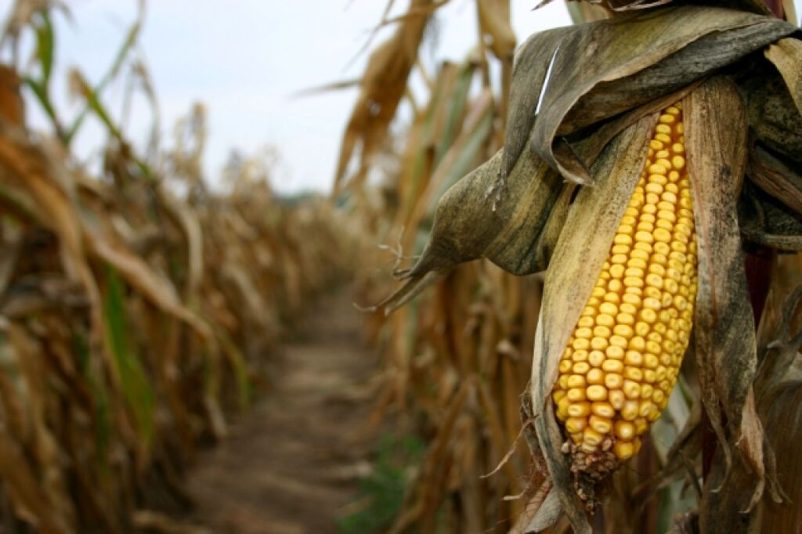
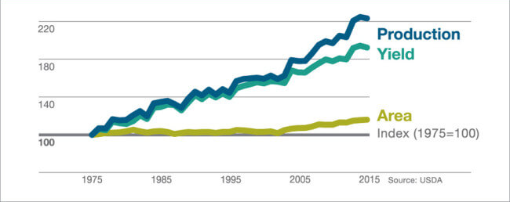
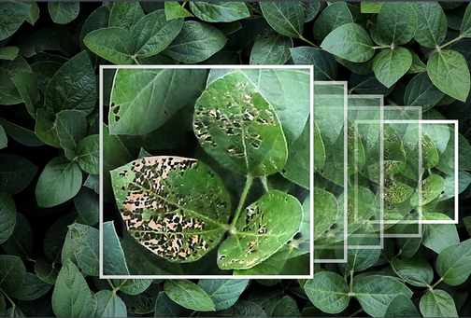
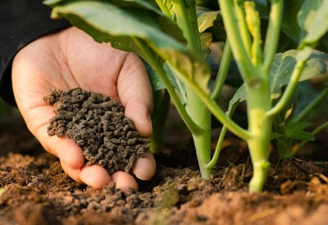
SMART LOGISTICS
DEEP CONVOLUTIONAL MODEL
CROP DISEASE
SOLUTION
OPTIMUM CROP PREDICTION
CROP YIELD PREDICTION
CROP DISEASE PREDICTION
FERTILIZER PREDICTION AND SOLUTION

Slide 6






Applicability :-
This can be used for the Traditional as well as trained farmers to upscale their productivity.
Our model will tell you which crop to grow based on soil , weather and geolocation .
Our model will tell you which fertilizer to use based on soil and other factors such as NPK and previous crop grown .
Predict the diseases found in crop before its outburst and also tell farmer about the prevention and solution.
Scaling of farming land will not have negative impact on any of our prediction accuracy.
MODEL
WEATHER
SOIL HEALTH CARD
MOBILE DEVICE
DATABASE
FARMER

